Slide 1
Timelapse Interactive record/replay for web apps
Brian Burg
Richard J. Bailey
Andrew J. Ko
Michael D. Ernst
Computer Science and Engineering
University of Washington

Slide 2



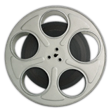
“It’s hard to debug failures in the field”
Distributed across time and space
Hardware and software variation
Users are not software testers
Notes:
A common challenge for developers at web companies is reproducing failures in their web applications.

Slide 3
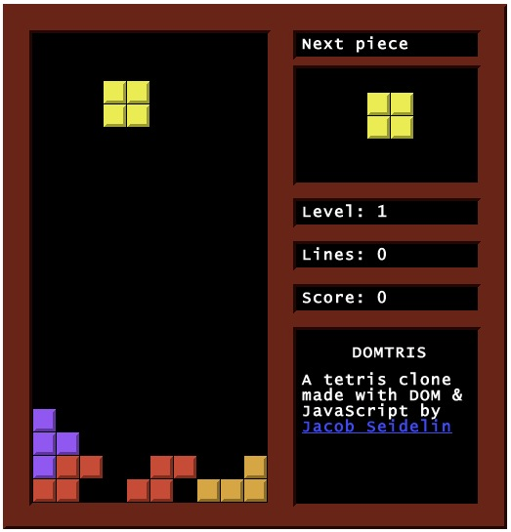
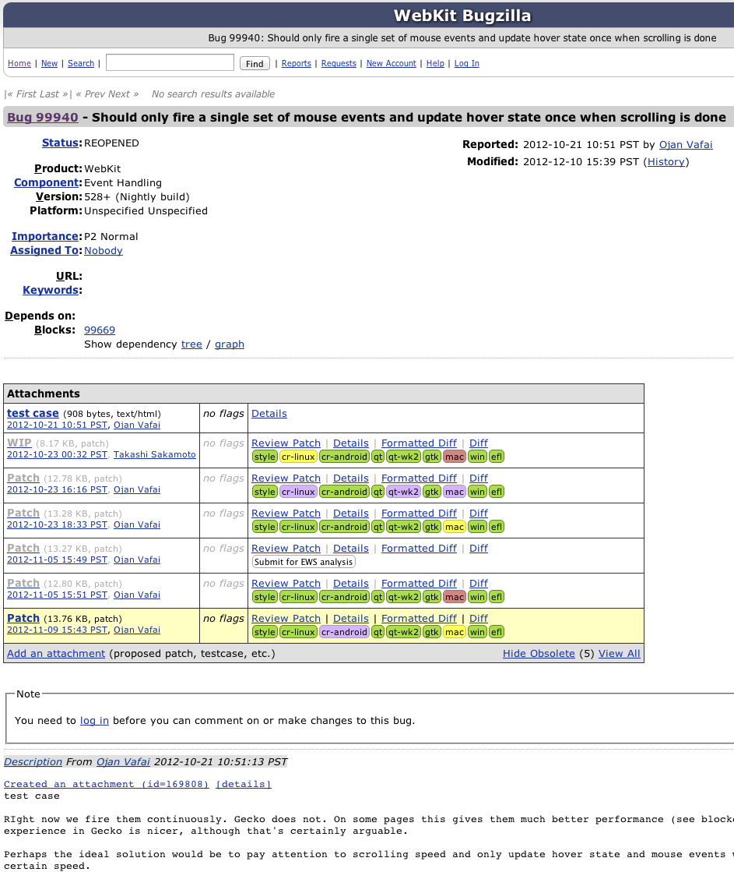
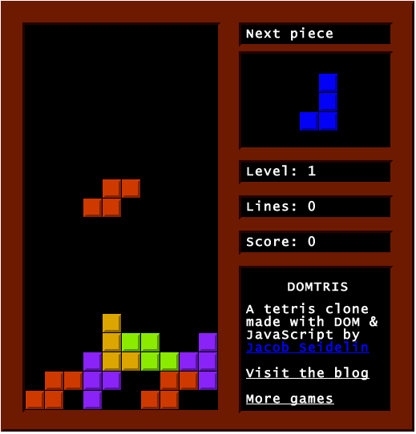



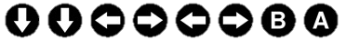
Users can’t report failures accurately
Works for me..
“a piece doesn’t rotate properly!!”
end-user encounters bug in production code
files bug report with
ad-hoc information
developer unable to reproduce the bug
Notes:
If users try to help, it may not be useful. They are focused on web app, not bug reporting.

Slide 4
Users can’t report failures accurately
Works for me..
“a piece doesn’t rotate properly!!”
“The most severe problems were errors in steps to reproduce and incomplete information.”
“What makes a good bug report”. Zimmerman et al. TSE Vol. 36, No. 5. 2010.
Notes:
In a recent study of open bug reporting in the Eclipse, Mozilla, and Apache projects, Zimmerman et al found that …

Slide 5
Users can’t report failures accurately
Works for me..
“a piece doesn’t rotate properly!!”
Bug reporters and developers want better tool support for reproducing buggy behavior.
“What makes a good bug report”. Zimmerman et al. TSE Vol. 36, No. 5. 2010.

Slide 6
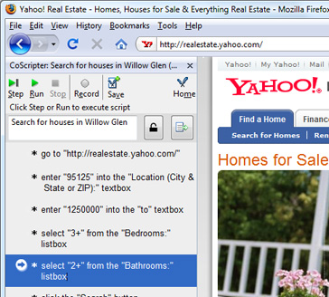
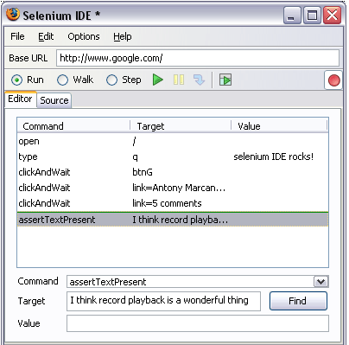
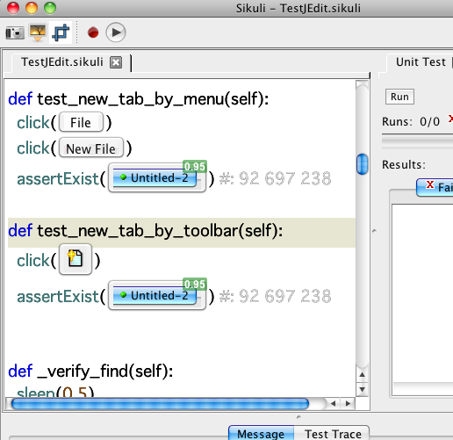
Existing tools are imprecise and hard to use
macro replay (CoScripter, Selenium, Sikuli)
Capture and simulate user input. Designed for test and task automation.
CoScripter
Leshed et al, CHI 2008
Selenium/
WebDriver
Sikuli Script
Yeh et al, UIST 2009
Notes:
Several tools exist for reproducing behavior, but I argue that these are inadequate for our use case.
Macro replay tools capture and simulate user input.

Slide 7
Existing tools are imprecise and hard to use
macro replay (CoScripter, Selenium, Sikuli)
Capture and simulate user input. Designed for test and task automation.
Nondeterministic. Requires extra setup ahead of time. Can’t use with a debugger.
deterministic replay (Mugshot, WaRR)
Save and reuse nondeterministic inputs
to exactly recreate a specific execution.
Play/pause buttons only. Slows down execution. Can’t use with a debugger.
Notes:
Deterministic replay tools try to capture and reuse all nondeterministic inputs, such as user input, random numbers, and network traffic.
However, prior deterministic replay tools for the web aren’t good enough: …

Slide 8
Timelapse: a precise, fast, integrated replay tool
This talk:
An interface for capturing and replaying program behavior
Techniques for cheap, precise record/replay in web browsers
How developers use record/replay during debugging tasks
Notes:
In this work, we present timelapse, a record and replay tool we developed that addresses shortcomings of prior approaches.

Slide 9
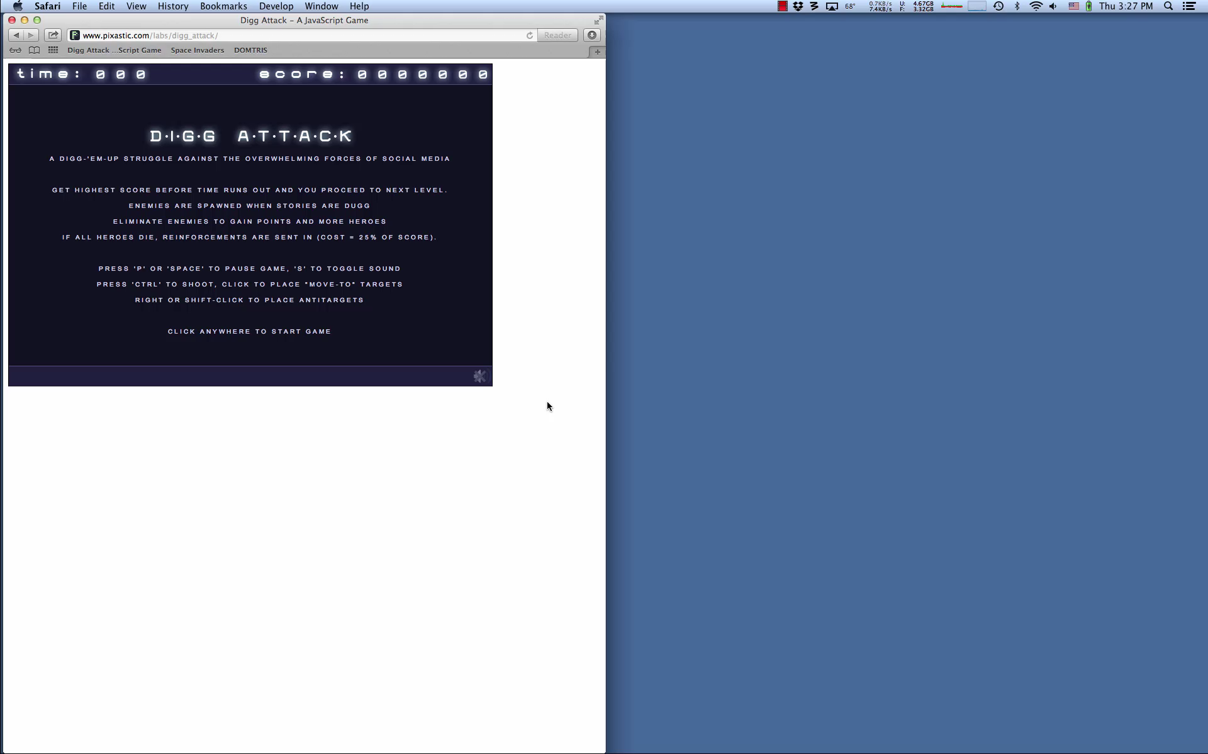
How to capture program behavior
Notes:
Timelapse is built into the Safari browser; to create a recording, we open the dev tools … open replay drawer
When start recording, page auto reloads. As we interact w/ program, we can see a ticker tape of the interaction history…

Slide 10
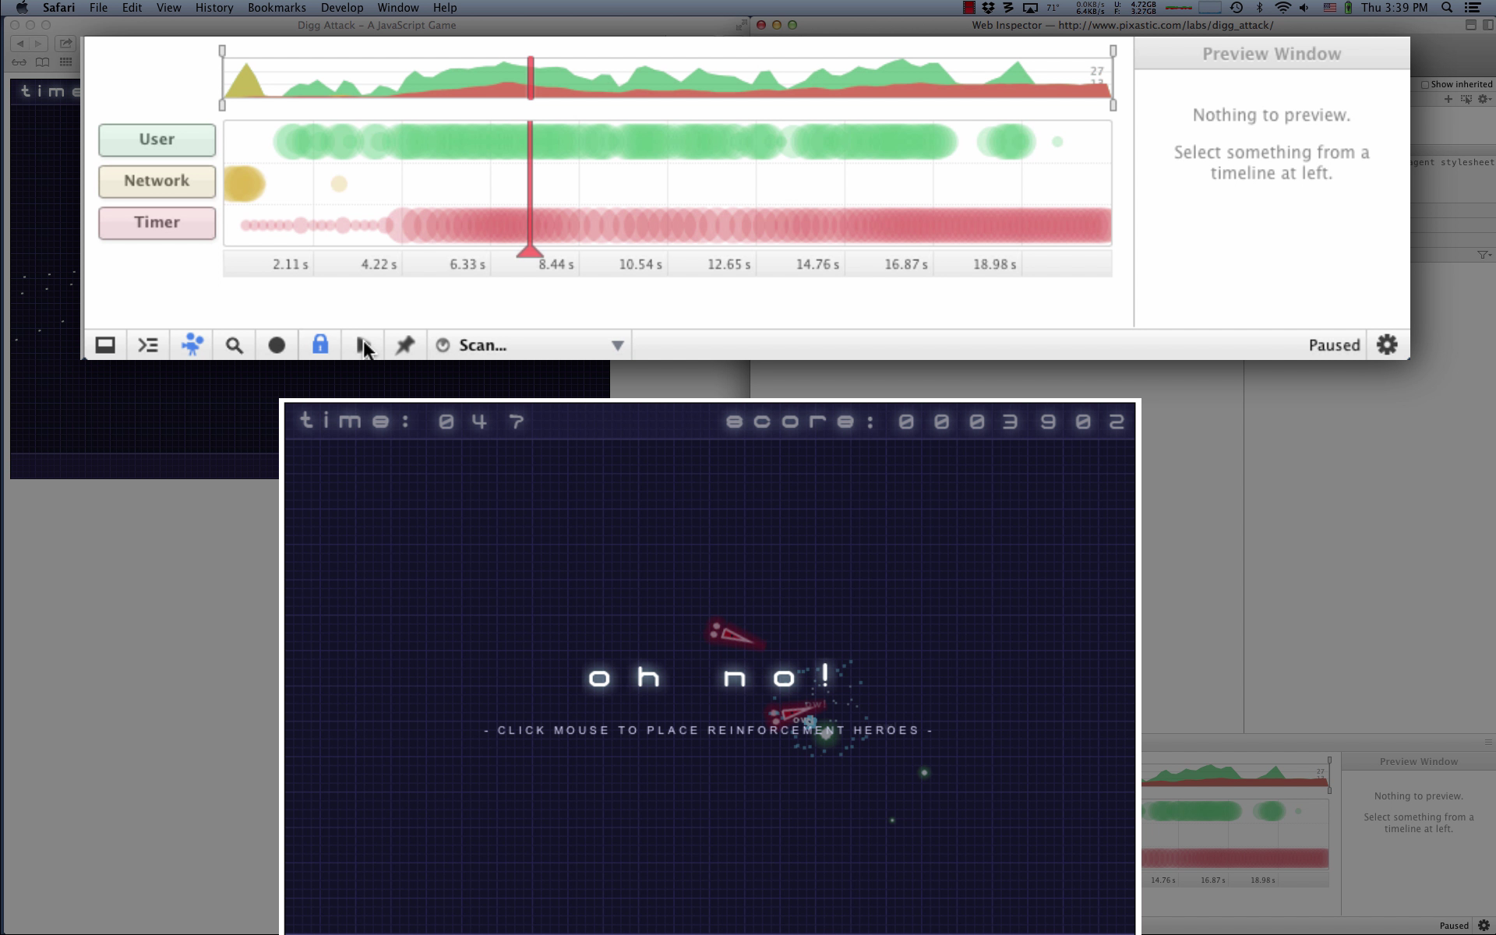
How to navigate a recording
Notes:
Once we stop capturing, we see an overview of the recording. Timelapse visualizes interaction histories over time to help users navigate through the recording and observe visual output. On top is an overview of the entire recording, and below is a zoomed view /PAUSE/ Each row contains different types of input---green user input, yellow network input, and red timer callbacks.
The size of a circle represents the amount of inputs per unit time; the contents of a circle can be inspected. The overview can be used to focus…
To move through the recording, the user can double click on an input or drag the red TIME SLIDER; when dropped, Timelapse will replay the recorded execution up to that point. Going backwards causes replay to start from the beginning and stop earlier. A traditional play and pause button allows the user to replay execution at the original speed.

Slide 11
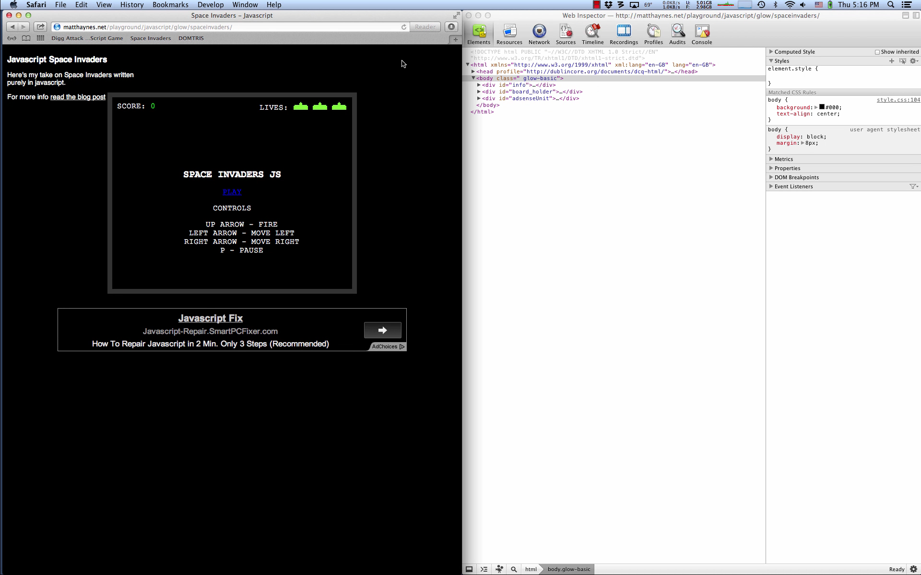
Using replay while debugging

Slide 12


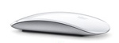




Browsers interpret input, render output
Browser Input (User, Network, Timers)
Web Interpreter (WebKit, Gecko)
Output
Notes:
At a high level, web rendering engines are stateful interpreters that turn inputs into outputs.

Slide 13
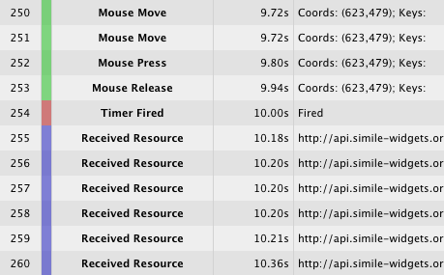

Timelapse captures a browser’s inputs
Inputs Log
Browser Input (User, Network, Timers)
Web Interpreter (WebKit, Gecko)
Output

Slide 14
Timelapse replays a browser’s inputs
Inputs Log
Web Interpreter (WebKit, Gecko)
Output

Slide 15





Browsers have layered architectures
User input, commands
Date.now, win.colorDepth
policy decisions
event loop callbacks
Embedders (Firefox, Safari, Chrome)
Web Interpreter (WebKit, Gecko)
Platforms
Notes:
Browsers have a nice layered architecture. Inputs cross layers, so it’s easy to identify inputs.

Slide 16
Timelapse intercepts input at layer boundaries
Embedders (Firefox, Safari, Chrome)
Web Interpreter (WebKit, Gecko)
Platforms

Slide 17
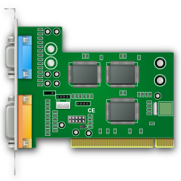
Inspired by VM record/replay
VM record/replay
Browser record/replay
Hardware interrupts
Nondeterministic instructions
Instruction counts
Async callbacks
Nondeterministic APIs
DOM event counts
Notes:
TODO: expand, make graphical?

Slide 18
Memoizing nondeterministic APIs
During normal execution, Date.now() returns the current time.
>> foo(a,b) { return a + b; }
>bar(c) { return “now:”+ Date.now(); }
/* file: Source/wtf/DateMath.h */
inline double jsCurrentTime()
{
return floor(WTF::currentTimeMS());
}
Web Interpreter
Platform API

Slide 19
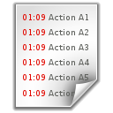
Memoizing nondeterministic APIs
During recording, the return value of Date.now() is saved.
>> foo(a,b) { return a + b; }
>bar(c) { return “now:”+ Date.now(); }
/* file: Source/wtf/DateMath.h */
inline double jsCurrentTime()
{
return floor(WTF::currentTimeMS());
}
Web Interpreter
Inputs Log
Platform API

Slide 20
Memoizing nondeterministic APIs
On replay, the logged return value of Date.now() is used.
>> foo(a,b) { return a + b; }
>bar(c) { return “now:”+ Date.now(); }
/* file: Source/wtf/DateMath.h */
inline double jsCurrentTime()
{
return floor(WTF::currentTimeMS());
}
Web Interpreter
Inputs Log
Platform API

Slide 21
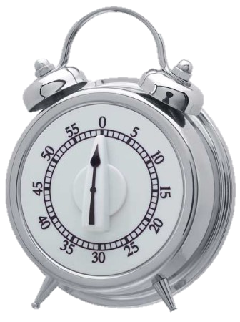
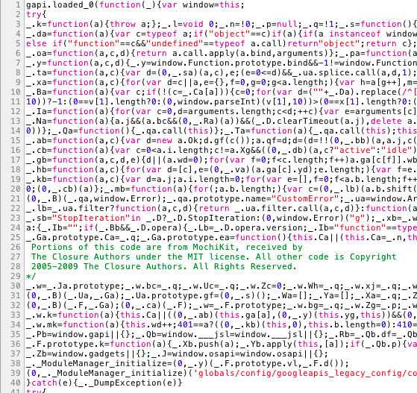
Making callbacks deterministic
enqueue()
Callback registered
while (true) {
var event = queue.pop();
this.dispatchToListeners(event);
}
Event Loop
timerFired()
Problem: accurately capturing and simulating event loop dispatches.
Callback executes
Notes:
Web interpreters schedule most of their work through an event loop. For an execution to behave deterministically, we need to take over a subset of the callbacks to make them fire in the order.

Slide 22
Making callbacks deterministic
enqueue()
Callback registered
while (true) {
var event = queue.pop();
this.dispatch(event);
}
Event Loop
timerFired()
timer 42, 34 DOM events
Callback executes
Inputs Log
Notes:
When timelapse is capturing, it observes and saves the original ordering of callbacks as they are dequeued from the event loop.
Timelapse saves the # of DOM events dispatched so far, which is used as proxy for execution progress.

Slide 23
Making callbacks deterministic
enqueue()
Callback registered
while (true) {
var event = queue.pop();
this.dispatchToListeners(event);
}
Event Loop
... ... ...
timerFired()
34 DOM events!
Inputs Log
Callback executes
Notes:
During replay, Timelapse allows work to be enqueued normally, but will block recorded callbacks that fire too early.
Later, when execution has progressed to the right point, Timelapse will invoke the callback itself.
Only callbacks that affect determinism (=visible to JavaScript) must be mediated. Layout and other async work converges; if script depends on it, then it is synchronous and doesn’t use event loop.

Slide 24
Runtime overheads are acceptable
Notes:
the performance of our record/replay technique is very good.
When capturing, up to 5% slowdown, doesn’t cause framerate drop
When replaying as fast as possible, several times faster than original execution.
When replay @1x, some time dilation because of inspector tools.
We haven’t optimized this (coalesce or suspend rendering)

Slide 25
Recordings are small and compressible
Site | recording duration (s) | resources on page (KB) | log growth (KB/sec)
JSLinux | 10.5 | 4500 | 0.8
JS Raytracer | 6.3 | 5.9 | 1.6
Space Invaders | 25.8 | 712 | 2.2
Mozilla.org | 22.3 | 2800 | 1.3
CodeMirror | 16.6 | 168 | 1.0
Colorpicker | 15.3 | 577 | 1.7
DuckDuckGo | 14.1 | 1900 | 2.1
Notes:
Timelapse recordings (excluding page resources) grow slowly, and can be compressed 10x using GZIP.

Slide 26
Page resources dominate recording size
Site | recording duration (s) | resources on page (KB) | log growth (KB/sec)
JSLinux | 10.5 | 4500 | 0.8
JS Raytracer | 6.3 | 5.9 | 1.6
Space Invaders | 25.8 | 712 | 2.2
Mozilla.org | 22.3 | 2800 | 1.3
CodeMirror | 16.6 | 168 | 1.0
Colorpicker | 15.3 | 577 | 1.7
DuckDuckGo | 14.1 | 1900 | 2.1
Notes:
When you compare the recorded inputs to the resources on the page (images, scripts, html, etc) the recording amounts to less than an image.
So they are small enough to send these over network, attach to mails or bug reports.

Slide 27
How would developers use it?
Study Design
20+ developers with industry experience
within-subjects, 2 tasks per person, 45 minutes per task, 4 treatments
Reproduction
RQ: changes to frequency/duration?
Performance
RQ: complete tasks more quickly? more successfully? Who, why?
Notes:
In general, users did NOT debug faster or slower. Why?
- only 10-25% spend on reproduction actions
- need time to integrate tool into workflow
- variable debugging skills and strategies
This is not surprising; consider same experiment w/ people using breakpoints for the first time.
Other comments: many wanted this for their own use. Industry/client-facing people wanted it for field failures, others for debugging.

Slide 28
How did developers use it?
Study Design
20+ developers with industry experience
within-subjects, 2 tasks per person, 45 minutes per task, 4 treatments
Reproduction
Shorter and more frequent repro actions; Time spent unchanged (max. 25%; avg.15%)
Successful developers quickly integrated replay into their existing workflows.
Performance
Unsuccessful developers who used opportunistic strategies were distracted.
Notes:
In general, users did NOT debug faster or slower. Why?
- only 10-25% spend on reproduction actions
- need time to integrate tool into workflow
- variable debugging skills and strategies
This is not surprising; consider same experiment w/ people using breakpoints for the first time.
Other comments: many wanted this for their own use. Industry/client-facing people wanted it for field failures, others for debugging.

Slide 29
Current & Future Work
Visualizations
Interaction histories aid navigation, but not program understanding.
Passive capturing
Precision and low overhead don’t matter if you forget to start capturing.
Post-hoc analysis
Developers can gather more runtime data without reproducing behavior:
Post-hoc logging, Post-hoc Whyline,
Post-hoc SeeSS, Testcase extraction

Slide 30
Conclusion
Record/Replay
Virtual machine replay techniques work well when applied to web applications.
Visualizations
Interaction histories supported–but didn’t reduce–reproduction of program state.
Infrastructure
Replay infrastructure enables new research, tools and workflows.
github.com/burg/timelapse

Slide 31
Replay fidelity and completeness
Divergence detection supports piecewise implementation.
Web interpreters expose a large and ever-changing API.
Timelapse doesn’t tame all sources of nondeterminism (yet).
Excepting untamed sources, the DOM tree and JavaScript heap are identical for all recorded and replayed executions.
Possible divergence is automatically detected when:
DOM event counts differ on capture and replay
Memoized inputs are overused or unused
Network request details differ unexpectedly
Known-bad APIs are used by client code

Slide 32

Interpreter inputs by source
User: mouse, keyboard, scroll, resize Network: images, scripts, HTML, AJAX Commands: page navigation
Internal nondeterminism: Animations, transitions, multimedia, async script and parser yields
Functions: Date.now, Math.random, etc Caching: resources, cookies Timers: timer schedule

Slide 33
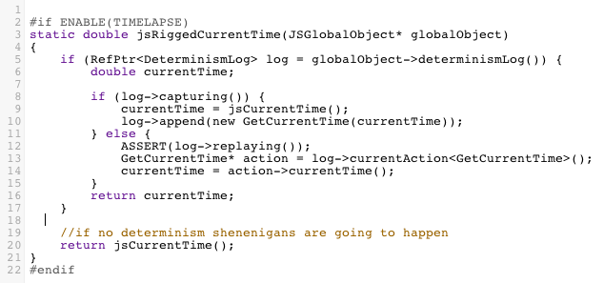
Shim: the thing in the middle
Shims are used to implement deterministic record/replay.
The hard part of implementing record/replay is designing and placing shims.

Slide 34
Embedding and platform APIs
Abstraction layers separate web interpreters from platforms/embedders.
EMBEDDING API
PLATFORM API
WebKit
Embedders
Web Interpreter (WebKit, Gecko)
Platforms

Slide 35
Embedding and platform APIs
Abstraction layers separate web interpreters from platforms/embedders.
EMBEDDING API
PLATFORM API
WebKit
Embedders
Web Interpreter (WebKit, Gecko)
Platforms

Slide 36
Embedding and platform APIs
Shims sit between the web interpreter and abstraction layers.
EMBEDDING API
PLATFORM API
WebKit
Embedders
Web Interpreter (WebKit, Gecko)
Platforms

Slide 37
Embedding and platform APIs
Shims sit between the web interpreter and abstraction layers.
EMBEDDING API
PLATFORM API
WebKit
Embedders
Web Interpreter (WebKit, Gecko)
Platforms

